Slide 1
Scrum Patterns
James O. Coplien
Gertrud & Cope

Slide 2
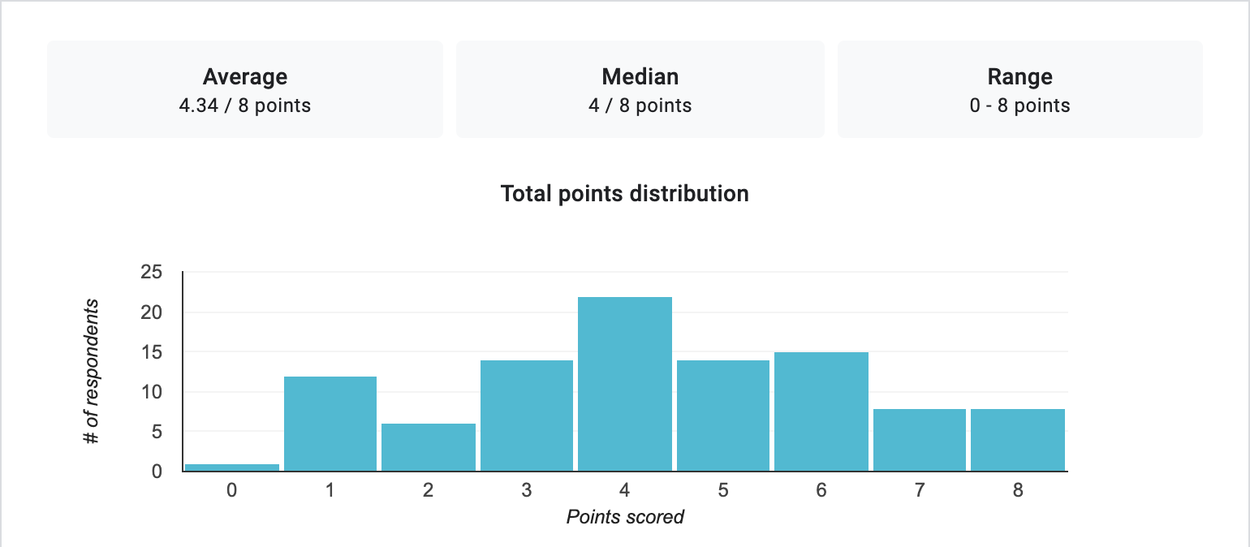
Mean score = 54%

Slide 3
What is the goal of the Daily Scrum?
✅
76%

Slide 4
The Product Backlog is:
✅
51%
76%

Slide 5
The Product Backlog is:
✅
50%
47%

Slide 6
The Product Backlog is a roadmap
✅
47%
51%

Slide 7
What is the Sprint Review?
✅
52%
50%

Slide 8
Which best describes the relationship between the Product Owner and the Dev Team?
✅
56%
52%

Slide 9
About what percentage of its Sprints should a great Scrum team fail, where “fail” is defined here as not completing everything on the Sprint Backlog?
✅
54%
56%

Slide 10
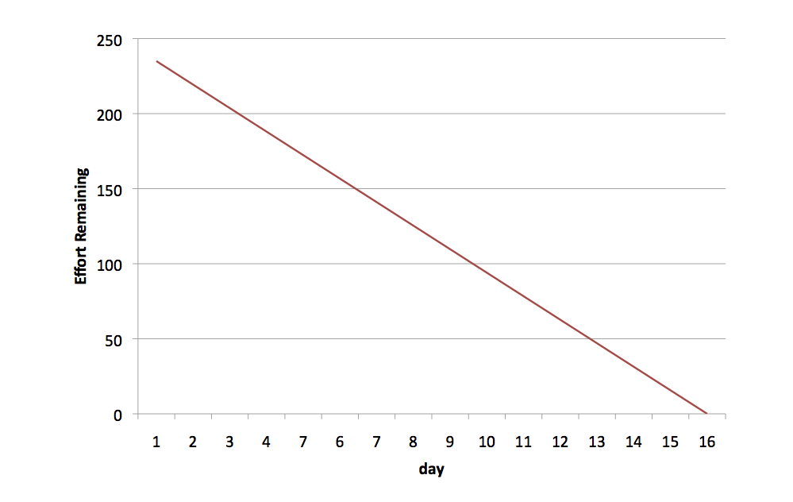




Probabilistic Planning
20% Variance
Half the Sprints don’t finish
Half the Sprints deliver more
Notes:
The Velocity has a mean and a variance, because precise prediction is impossible in a complex system. We can show this on the trajectory of the Burn-down chart. Let’s say that a team has a Velocity of 235 ± 20%, where “± 20%” covers two standard deviations of variance (so 95% of all Sprints will have a velocity between 188 and 282).
Half of the Sprints won’t finish and will have a leakage of as much as 20% of the work on the Sprint Backlog. Half of the Sprints will be able to deliver more than forecast: as much as 20% more.

Slide 11



Deming: Reduce the Variance
10% Variance
Half the Sprints don’t finish
Half the Sprints deliver more
… but the leakage is cut in half
Notes:
Producing too little can cause shortfall for market demand; producing too much can lead to warehousing problems, or with customers feeling they paid for the development of something they didn’t need or didn’t want.
To mitigate these problems, it is good to reduce the velocity’s variance. The team will still overproduce 50% of the time and underproduce 50% of the time, but the waste and leakage will be smaller, respectively.
Reduce variance by improving the quality of your specifications to the team; by ensuring that all Developer work is on the Product Backlog; by minimising disruptions to the team during development, and by keeping a stable team.

Slide 12
What is the value of certification in the area of managing projects?
✅
55%
54%

Slide 13
More on Scores
Overall: 54.25%
Certified: 55.76%
Scrum Alliance: 50%
Scrum.org: 57.23%
SAFe: 36.4%

Slide 14
Patterns
À la
carte rather than
all or nothing
Piecemeal
rather than
all at once
Authoritative
rather than
certified
Raising the
Bar

Slide 15

Developing Grounded Understanding
Look at https://www.velocitymadegoodllc.com/resources/scrum-ceremony-1-pagers:
“Task WIP limit = 1 per person”
“Suggested agenda: Story-by-story review (starting with most complete) and plan for the day (10 min.)
“Impediments review, action, and owner (5 min.)”
“Determine the paired programming pairs for the day”

Slide 16
No, I mean real patterns
From: "Helm Richard" <Helm.Richard@BCG.com>
Date: December 2, 2004 1:36:05 AM IST
To: <JOCoplien@cs.com>
Subject: Confession.... and a request...
Hi Cope
Can't recall last time we spoke or met but its been ages...
The confession....
Finally grok'ed "generative patterns" and piecemeal growth through a long tortuous route....
Largely through some interesting universal properties of software (scale-free and small-worldness)
A bit slow I am sometimes... but got there in the end…
. . . .

Slide 17


Slide 18
A pattern: Ten Word Line
The human eye moves in discrete motions ending in periods of detail-absorbing stability called fixes. A proficient reader interprets several words with each fix across a line. However, when returning to the left margin, several fixes can be wasted locating the continuation of a sentence.
Therefore: Compose text into lines averaging ten words or less, for casual reading, and even narrower for speed reading. When formatting an 8-1/2 x 11 page, use two columns. When reading text-rich web pages (such as this), resize your browser to narrow the column width to within the ten word limit. (Really, try it now.) Consider formatting web pages within tables of specified pixel width so that your reader will not have to adjust their browser . — Ward Cunningham
Set your browser to make all (and only) dashes on one line:
--- ---- ---- ---- ---- ---- ---- ---- ---- ----
Notes:
11:00

Slide 19

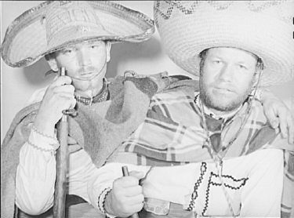
DEVELOPING IN PAIRS
Software development is mistake-prone
Reviews are insufficient
Allow, but don’t force people to work in pairs

Slide 20
Patterns: Time-proven forms
Tom Gilb: “A term coined by Jim Coplien in 1995.”
Trygve Reenskaug: “Anne Lise Skaar and I did a large (75000 lines Smalltalk code) project combining literate programming and pair programming in the middle to late 80ties.”
Larry Constantine: “My name comes up in connection with pair programming because I taught and wrote about the practice ("The Benefits of Visibility" Computer Language Magazine 9, 2, 1992) years before the advent of agile, but I most decidedly did not invent it. I learned about the technique from P. J. Plauger who used it as a production programming technique at Whitesmiths Ltd., where I saw it in 1978 or 1979 being used to code C compilers for the PDP-11.”
Ed Yourdon: “PJ Plauger … was instrumental in persuading me to get UNIX in our company (which had a $10,000 license fee at the time, a sum of money which Plauger lent the company, interest-free!). And even the dumb typewriter-like terminals at the time cost about $3,000 -- so we couldn't afford to get very many of them… Consequently, Plauger told the motley crew of programmers in our place that they should ‘pair up’ and share the terminals; it simply reflected the fact that hardware was still more expensive than people.”
Jerry Weinberg: “I learned to pair program (on paper--we didn't even have terminals back in the 1950s) in Los Angeles, from Bernie Dimsdale, who learned it from John von Neuman. I don't know if it has any history before then, but that's way back to Aberdeen Proving Grounds in the 40s.”
Ed Yourdon again: “It's gonna go all the way back to Charles Babbage, or Lady Lovelace!”
Brian Kernighan: “I have no recollection of any of the history of pair programming, and I certainly have no involvement with it at all.”

Slide 21

How do you read a pattern?
§ 29
Daily Scrum
... a Scrum Team has been formed and it is ready to start, or has started a Sprint. As such, the Scrum team has created a Sprint Backlog and is working to achieve the Sprint Goal. Yet, in the words of Field Marshall von Moltke, “no plan of operations extends with any certainty beyond the first contact with the main hostile force.”
* * *

Slide 22
Pattern forces
The team makes progress in a Sprint by finishing Sprint Backlog Items, but given the complexity of the work, the characteristics, size and quantity of tasks change frequently — sometimes minute by minute.
Because of the changing nature of the work, the team needs to adopt a new ordering at least once a day to move beyond mediocrity.
On the other hand, too much re-planning and re-estimating wastes time and suffocates developers. But too little re-planning and re-estimating leads to blockages that cause delays or obsolete plans that no longer represent reality

Slide 23
Solution
Therefore:
Have a short event every day to replan the Sprint, focusing on the next 24 hours. Strictly time-box the meeting to keep focus on the daily plan and to avoid robbing time from development.
Keep the meeting to 15 minutes or less. The team manages itself to its timebox, and the ScrumMaster will enforce this aspect of the process if necessary. Many teams stand during the meeting to emphasize the short duration of the meeting.

Slide 24

More Solution
In order to plan, you must know where you are, as well as what problems are standing in the way. And you need a complete picture. One approach is for each person in the Development Team to answer the following three questions:
What did I do yesterday that helped the Development Team meet the Sprint Goal?
What will I do today to help the Development Team meet the Sprint Goal?
Do I see any impediment that hinders me or the Development Team from meeting the Sprint Goal?
* * *

Slide 25
Resulting Context
The ethos of the Daily Scrum is a reality check: will we meet the Sprint Goal? The result of the Daily Scrum is a new daily plan grounded in reality, and generates a team that is more prone to cooperate and that has a better shared vision and understanding of what they are doing together. The team becomes better attuned to the landscape of impediments in which they are working.
The ritual of Daily Scrums helps a sense of team identity emerge from a group of people. It brings them together to refocus on their shared purpose and common identity. It reinforces Team Pride. In some way, it is a daily version of Face-to-Face Before Working Remotely.

Slide 26
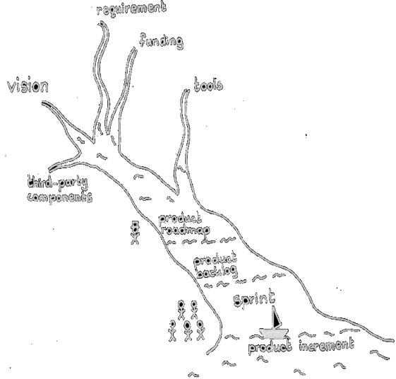

What is Scrum?
A framework, like all the books say
… for building a product (we all hate projects, right)?
NO — for building a process and organization
The process and organization in turn build a product

Slide 27
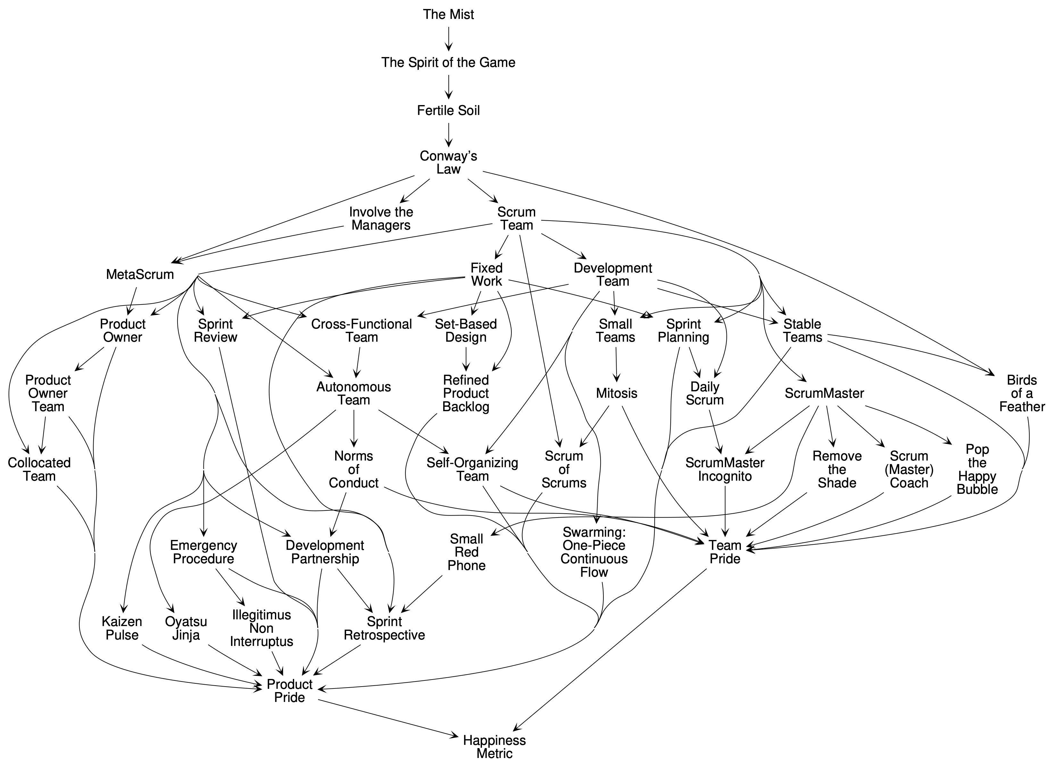
Scrum as Org Patterns:
The Organizational
Structure

Slide 28
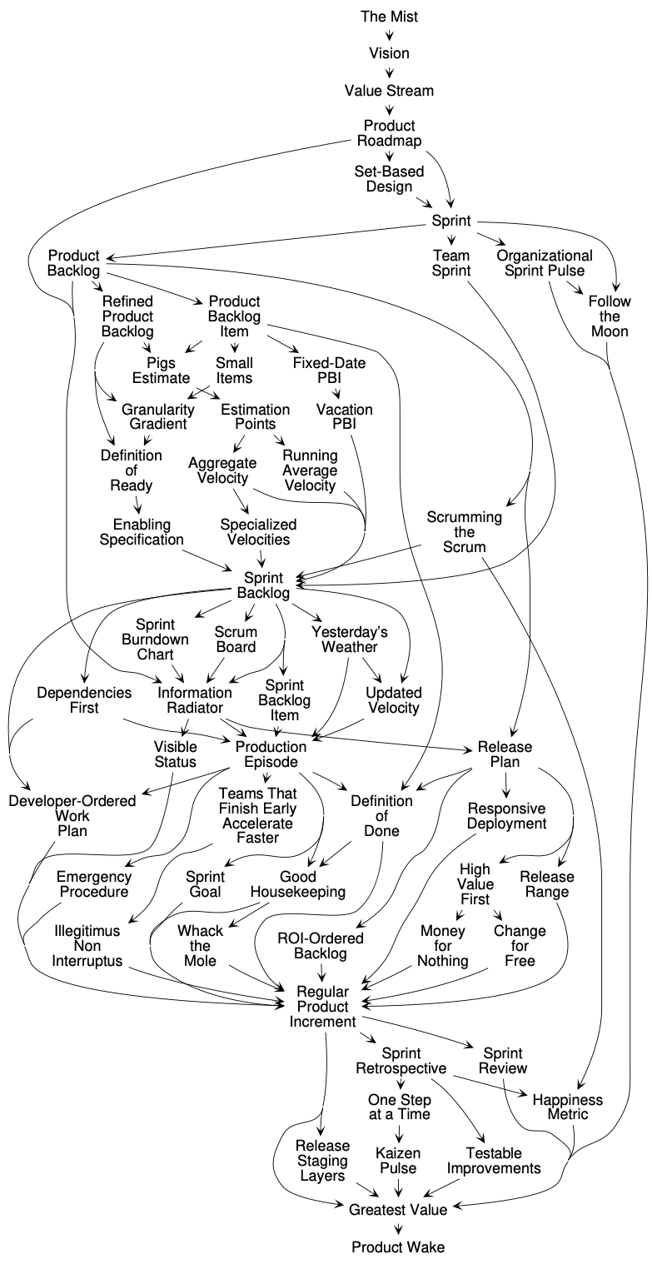
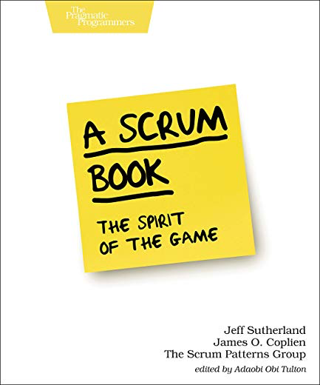
The second half of the patterns: the Value Stream

Slide 29



Product Backlog
§ 54
...you have defined a Value Stream by which the Product Owner’s Vision flows to the market. …The Development Team needs guidance on how to interact with the Product Owner to support the best implementation of the Vision, and to ultimately have a foundation for a good tactical direction for each Sprint.
* * *
At any given time, it is important that the whole team is aligned about what it needs to deliver next, and that the direction be transparent. The Development Team can’t do everything at once—in fact, you can’t even do two things well at the same time. It’s important to maintain focus.
.…
Therefore: For each product, create a single ordered list called the Product Backlog—a list of Product Increment contributions called Product Backlog Items (PBIs), arranged in their expected delivery order. The Product Backlog details the Product Owner’s Vision for the product as informed by the expectations of all stakeholders, with each PBI describing a contribution to a deliverable Product Increment. …
Contains Product Increments
No user stories
PBIs are not deliverables

Slide 30
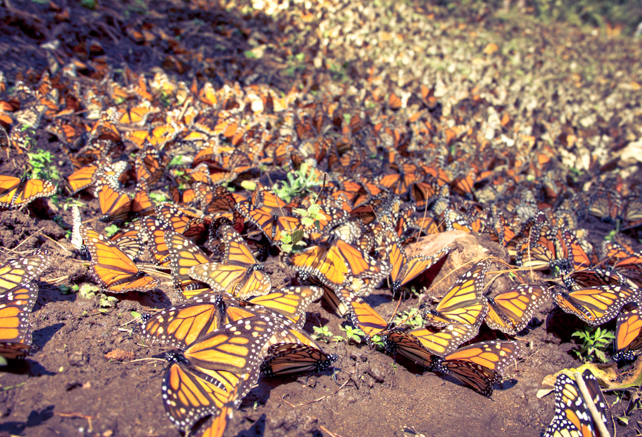
Birds of a Feather
§ 5
The main organizational structure should support interactions for product development
Core competencies are also important to success and often are not properly nurtured within the development structure
Therefore: Create a structure orthogonal to the development structure to support professional association and work
P-3

Slide 31
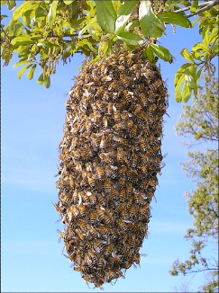
§ 25
Swarming
... companies, teams, and individuals often fail to get things Done by working on too many things at once and not working together to help one another finish the highest priority Sprint Backlog Items. While it is the Product Owner’s responsibility to order the product backlog to maximize value delivery, it is the responsibility of the ScrumMaster and Development Team to order the implementation of the Sprint Backlog to maximize flow of production.
* * *
Working on too many things at once can radically reduce individual effectiveness, team velocity, or a enterprise well-being. It can cripple velocity and can sometimes reduce it to zero.
A team works on multiple items at once resulting in excessive work in process, low process efficiency and associated delays.
Therefore:
Focus maximum team effort on one item in the Sprint Backlog and get it done as soon as possible. Whoever takes this item is Captain of the team. Everyone must help the Captain if they can and no one can interrupt the Captain. As soon as the Captain is Done, whoever takes responsibility for the next priority backlog item is Captain.
Implementing this pattern moves the team toward one-piece continuous flow. Toyota demonstrated that this optimizes production capacity…

Slide 32
Good Housekeeping
§ 80
Velocity is limited because a team spends time dealing with too many bugs.
However, keeping a bug list causes numerous problems… In short, deferring the fixing of bugs until later is borrowing against your future velocity.
Therefore:
Fix all bugs in less than a day. Aim to have a completely clean base of code at the end of every day.

Slide 33
Yesterday’s Weather
§ 66
Guessing when you will be done with a complex task is always a dicey proposition
Yet complex processes have norms.
Therefore: Use the last Sprint, or the trend of the most recent Sprints, to determine how much work to take into the next Sprint.

Slide 34

Enabling Specification
§ 63
Unexplored requirements cause unpleasant surprises.
It's easy to throw requirements over the wall and say: "That requirement was covered." It's even easier in Scrum. Their user stories are enough. And the Agile culture encourages deferring decisions and a ready, at-hand on-site customer who can compensate for requirements lapses during development.
Therefore: The Product Owner should deliver enabling specifications as a sign that he or she has done due diligence in exploring the requirements space. "Enabling specification" means that the specification is rich enough that someone reasonably skilled in the discipline can implement a solution without substantial subsequent clarification.
Scrum secret:
There are no
User Stories in
Scrum

Slide 35
Illegitimus Non Interruptus
§ 33
Allot time for interrupts and do not allow the time to be exceeded.
Set up three simple rules that will cause the company to self-organize to avoid disrupting production.
The team creates a buffer for unexpected items based on historical data. For example, 30% of the team's work on the average is caused by unplanned work coming into the Sprint unexpectedly. If the team velocity averages 60 points, 20 points will be reserved for the interrupt buffer.
All requests must go through the Product Owner for triage. The Product Owner will give some items low priority if there is no perceived value relative to the business plan. Many other items will be pushed to subsequent Sprints even if they have immediate value. A few items are critical and must be done in the current Sprint, so they are put into the interrupt buffer by the Product Owner.
If the buffer starts to overflow, i.e. the Product Owner puts one point more than 20 points into the Sprint, the team must automatically abort, the Sprint must be re-planned, and management is notified that dates will slip.

Slide 36
Dependencies First
§ 79
The team orders the Sprint Backlog to reflect known dependencies at the beginning of the Sprint, but the variance in the effort necessary to realize PBI delivery, and to re-plan due to Emergent Requirements, can push dependency resolution too late in the Sprint and can thereby increase the risk that the dependency will cause PBIs to be inadvertently dropped.
Therefore:
Make sure that all foreseen dependencies are in-hand by mid-Sprint; otherwise, abort the Sprint.

Slide 37
MetaScrum
§ 37
Products within an enterprise need to coordinate and set the direction they own
Management has an opinion and steers the teams
Encapsulate all management input in one weekly event, retaining the PO’s authority over product direction
The National Advisory Committee for Aeronautics in session at Washington to discuss plans to place America foremost in the development of aviation.

Slide 38

More…
amazon.com
scrumbook.org
facebook.com/scrumplop
Courses:
gertrudandcope.com

